Slide 1
Suicide Rates Overview 1985 to 2016 Compares socio-economic info with suicide rates by year and country
Liptika Dhal

Slide 2
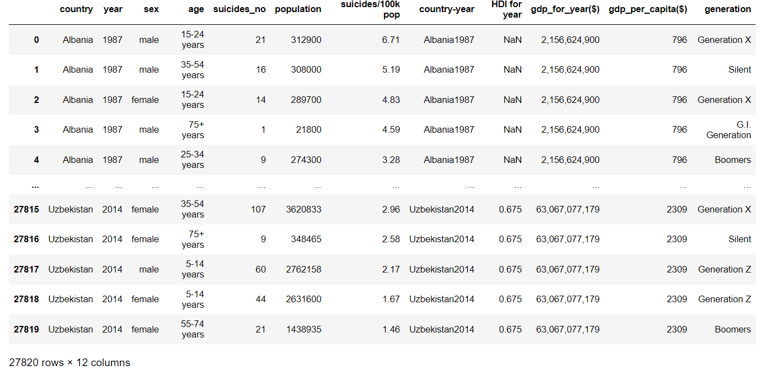
This compiled dataset pulled from four other datasets linked by time and place, and was built to find signals correlated to increased suicide rates among different cohorts globally, across the socio-economic spectrum. This dataset contains following attributes country, year, sex, age, suicides_no, population, suicides/100k pop, country-year,HDI for year, gdp_for_year($), gdp_per_capita($), generation

Slide 3
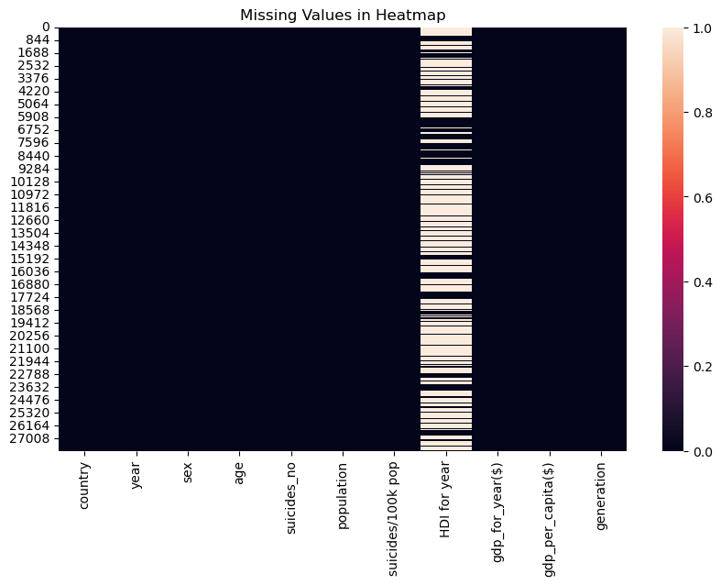
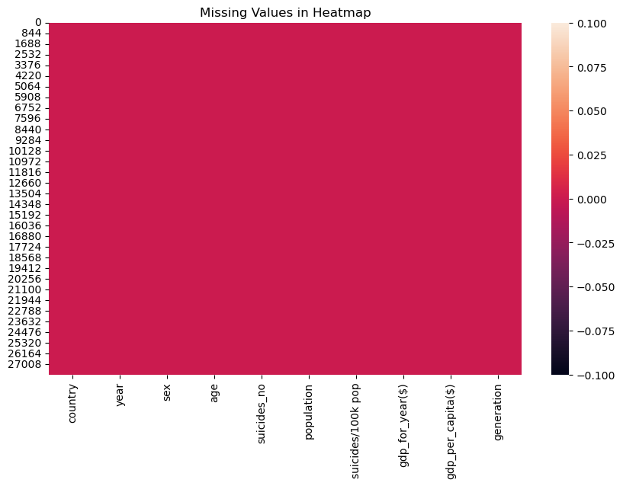
Missing Values Treatment
Before null values removal
After null values removal

Slide 4
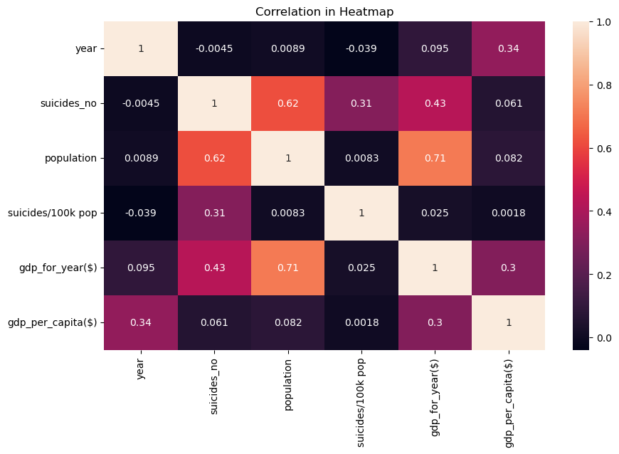
Finding out the correlation among attributes

Slide 5
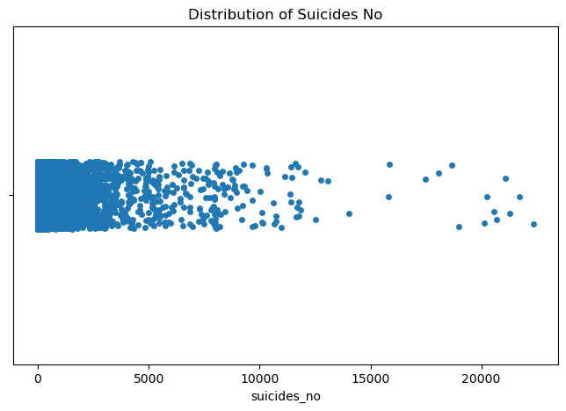
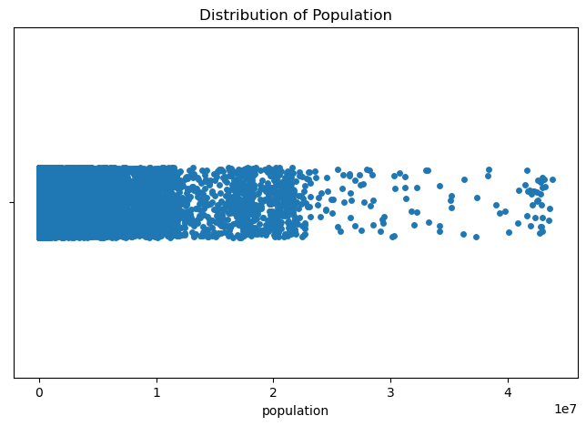
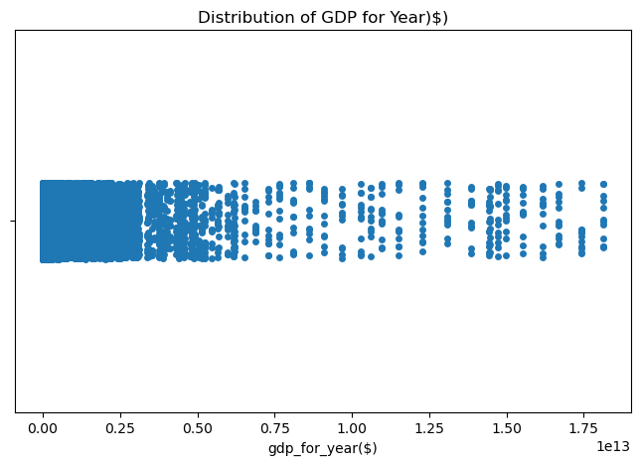
Univariate Analysis of Numerical Attributes
The attribute Suicide No,
distribution is extreme right skewed.
Most of the observations are between
0 to 1000. Occurrence of datapoint
more than 5000 is quite rare.
Population distribution is extremely
right skewed
In this dataset, GDP for Year distribution
is also right skewed. Also, most
of the datapoints lies between
(0.00le13 - 0.60le13).

Slide 6
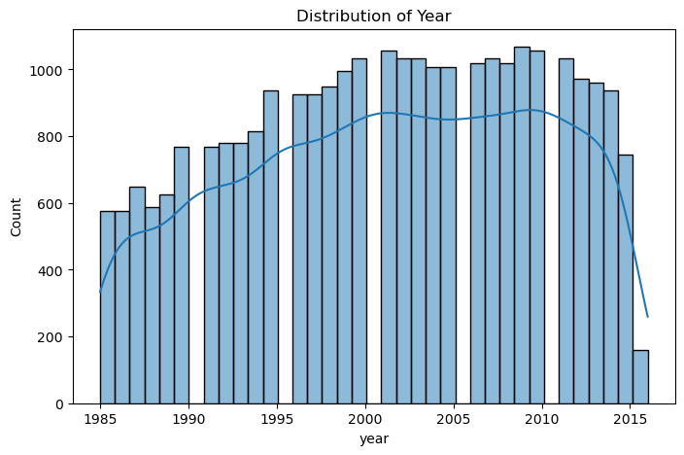
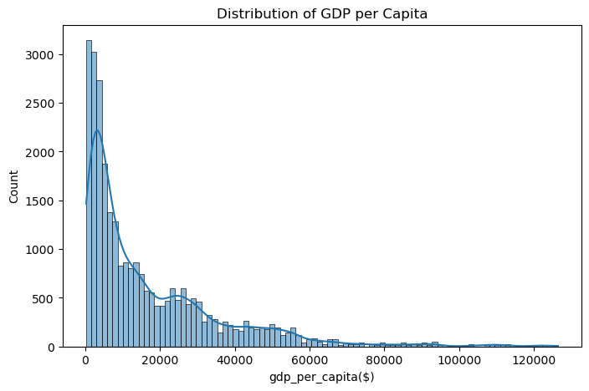
The attribute of “Distribution of Year” is fairly bell-shaped with maximum data lies between the decade of the year 2000 to 2010.
The attribute of “GDP per Capita” falls under the category of extreme right skewed where few datapoints can go up to 125000$ whereas the mean is 16866$ approximately.

Slide 7
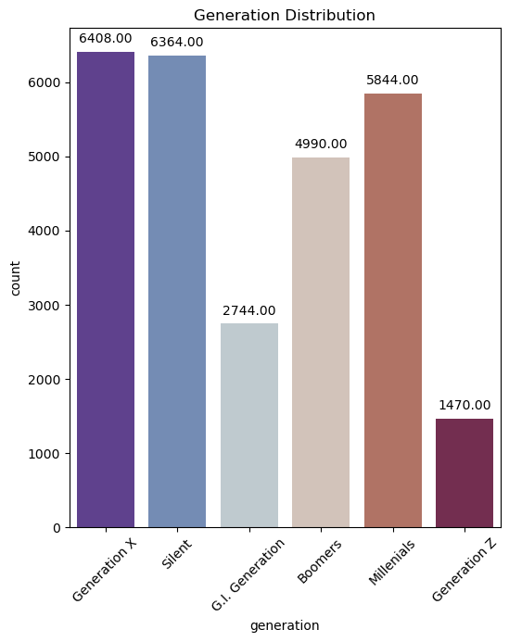
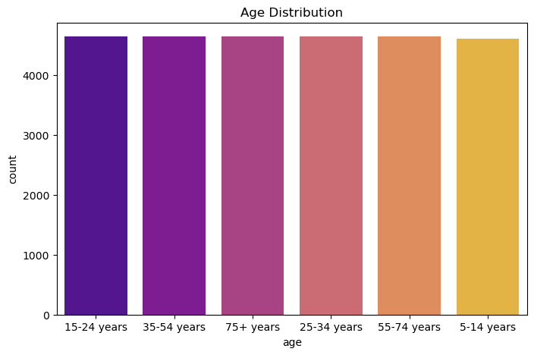
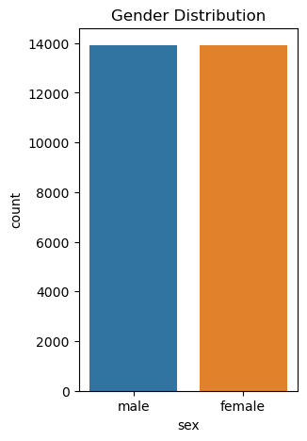
Univariate Analysis for Categorical Attributes
In this survey,
number of male & female are equal.
Every age group has almost equal
number of datapoints.
Most of the datapoints are in
Generation X and Silent followed by
Millennials, Boomers, C.I. Generation,
Generation Z.

Slide 8
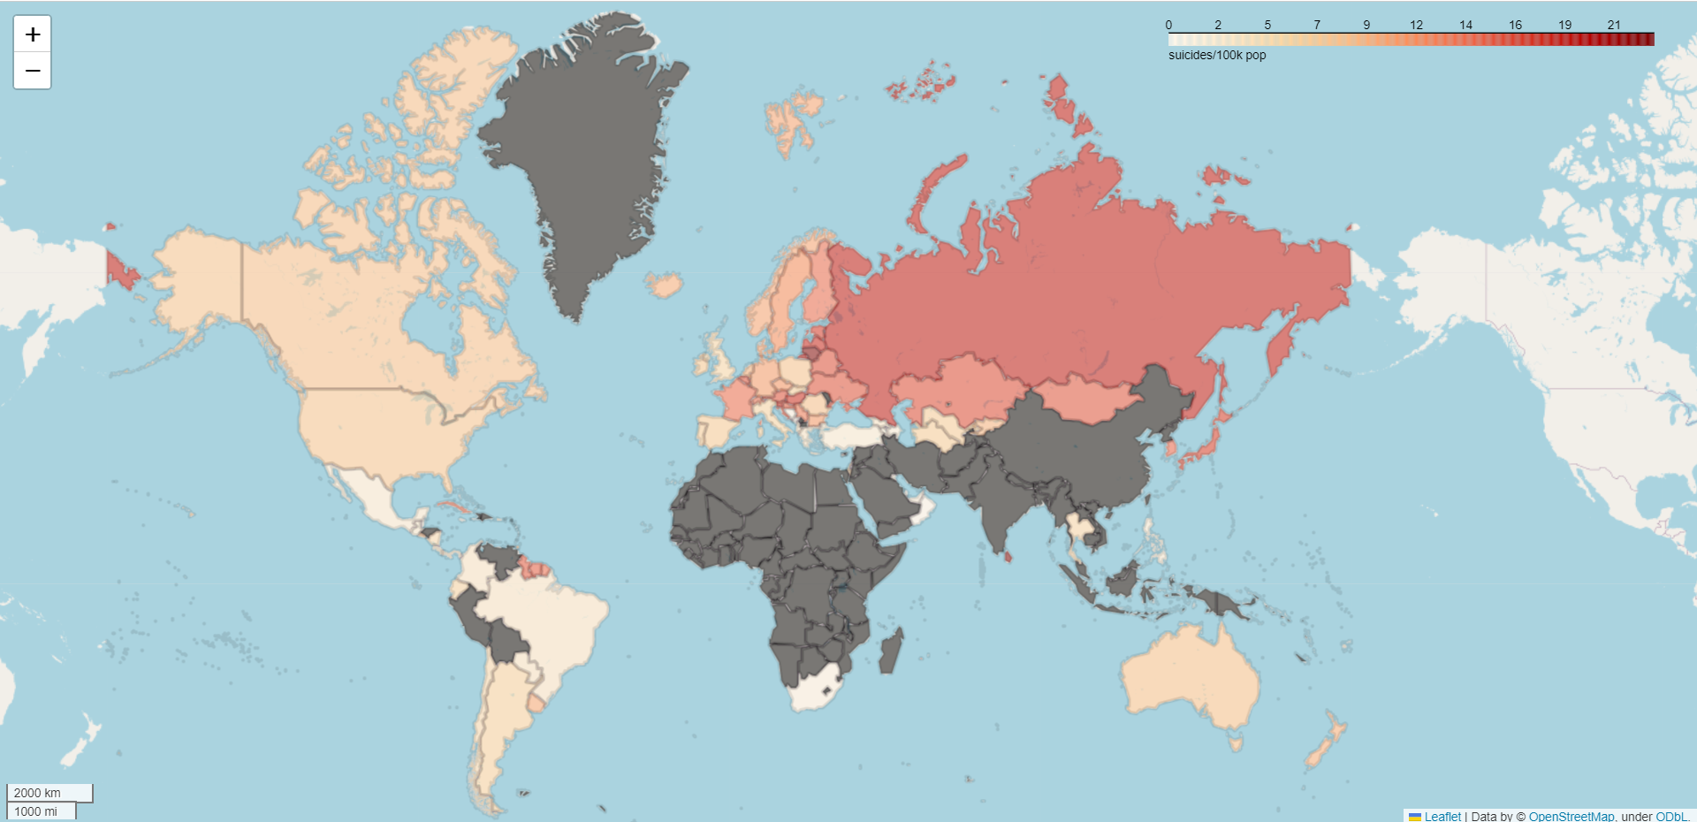
Bivariate Analysis

Slide 9
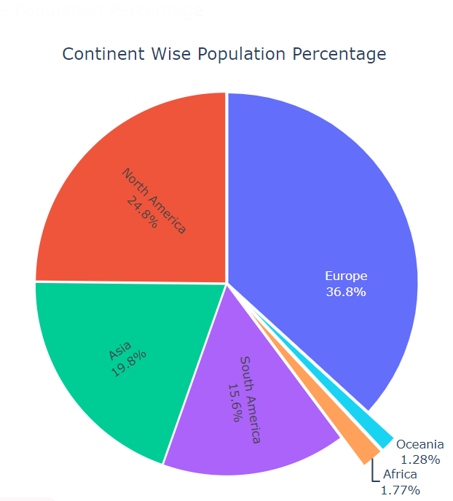
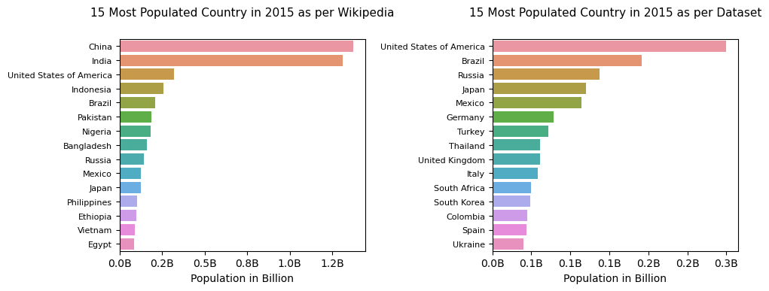

Slide 10
